Slide 1
SLAM in ROS
Prepared by: Mohamed khaled

Slide 2
Introduction to SLAM

Slide 3
Definition
SLAM (Simultaneous Localization and Mapping) in ROS (Robot Operating System) is a process that enables a robot to create a map of its environment while simultaneously tracking its location within that map.
SLAM is an essential piece in robotics that helps robots to estimate their pose – the position and orientation – on the map while creating the map of the environment to carry out autonomous activities.

Slide 4
Comparison with Human Wayfinding
Humans naturally use landmarks to navigate. A building or street sign may help you locate yourself as you travel down a street. This is wayfinding.
Robots can use SLAM to map their surroundings and track their location, just like humans utilise landmarks. SLAM and human wayfinding use distance measurements and 3D models. In circumstances when GPS is inaccurate, SLAM is more resistant to environmental changes and can be used. SLAM uses less energy than GPS because it doesn't need satellite communication.
A robot or unmanned vehicle can construct a map of its surroundings and track its whereabouts using SLAM. Sensors like lasers help the SLAM system detect distances and construct a 3D scene. The purpose of all SLAM algorithms is to construct an accurate world map and track the vehicle's location inside it. Autonomous vehicles like self-driving cars and drones need SLAM for indoor and outdoor navigation.

Slide 5
Mapping with GMapping

Slide 6
Overview
While it sounds simple, creating a map is not an easy task, especially for a robot. To get started, a type of visual detector, like a camera or a lidar sensor, is used to record the surroundings. As the robot moves, it captures more visual information and tries to make connections and extract features – like a corner – to mark some identifiable points. However, some of the features could look very similar and be difficult for a robot to distinguish which is which. This is when localization becomes useful for creating more accurate maps via SLAM.
GMapping is a widely used algorithm in robotics for building a map of an environment while simultaneously localizing the robot within that map. This algorithm is particularly noted for its effectiveness in handling indoor environments where GPS is not available.

Slide 7
Key Components
Particle Filter Framework: GMapping is based on a particle filter. In this context, each particle represents a hypothesis (assumption) of the robot’s trajectory (path). Along with the trajectory, each particle maintains its own map of the environment.
Initialization: At the start, the algorithm initializes a set of particles with random trajectories. Initially, these particles have their own individual maps, which are mostly empty or uncertain.
Motion Update: When the robot moves, the algorithm updates the trajectory of each particle according to the robot’s motion model. This model accounts for the noise and uncertainty in the robot’s movements.

Slide 8
Key Components
Sensor Update and Map Building: Each particle updates its map based on the new sensor data (e.g., from laser range finders). The algorithm uses a process called scan matching to align the new sensor data with the existing map. This alignment is crucial for accurately integrating new information into the map.
Weight Assignment: Each particle is assigned a weight based on how well its map explains the observed sensor data. Particles whose maps align well with the sensor data receive higher weights.
Resampling: The algorithm periodically performs a resampling step, where particles with higher weights are more likely to be replicated while those with lower weights are discarded. This focuses the particle set on the most probable trajectories.

Slide 9
Key Components
Map Generation: As the robot explores the environment, the maps maintained by the particles get increasingly detailed. The final map is typically derived from the particle(s) with the highest weight, as these represent the most likely trajectory and the corresponding map.
Loop Closure: GMapping can handle the loop closure, where the robot recognizes a previously visited area and can accordingly adjust its map and trajectory estimates to be consistent with this recognition. This is important for maintaining accurate maps over long distances.
Computational Efficiency: One of the strengths of GMapping is its computational efficiency, making it suitable for real-time applications on robots with limited processing power.

Slide 10
Localization with AMCL

Slide 11
Overview
When an autonomous robot is turned on, the first thing it does is identify where it is. In a typical localization scenario, a robot is equipped with sensors to scan its surroundings and monitor its movements. Using the inputs from the sensors, the robot is able to identify where it is on a given map. In some cases, a tracking device like a GPS is used to assist the localization process (this is how Google can give us the blue dot on Google Maps, for example).
One of the most popular localization techniques is Adaptive Monte Carlo Localization (AMCL), which is a probabilistic algorithm that uses a particle filter to estimate a robot's position and orientation in real-time.

Slide 12
Basics of Robot Localization
Robot localization is the process of determining the pose of a robot within a known or unknown environment. The pose of a robot includes its position (x, y, z) and orientation (roll, pitch, yaw) relative to a reference coordinate frame.
There are several methods for robot localization, including odometry, GPS, and landmark-based methods. Odometry relies on measuring the rotation and displacement of a robot’s wheels or other locomotion mechanisms, while GPS uses satellite signals to determine a robot’s global position. Landmark-based methods rely on identifying and tracking distinct features in an environment, such as walls or corners.

Slide 13
Understanding the AMCL Algorithm
AMCL is a probabilistic algorithm that uses a particle filter to estimate a robot’s 2D pose based on sensor data. The algorithm works by representing the robot’s pose as a distribution of particles, where each particle represents a possible pose of the robot.
At each time step, the robot takes sensor measurements and compares them to a map of the environment to determine the likelihood of each particle being the true pose of the robot. The particles with low likelihoods are discarded, while the particles with high likelihoods are resampled to generate a new set of particles for the next time step.
The process of resampling ensures that the particles remain distributed around the true pose of the robot, even if the robot’s movement is uncertain or the environment is partially observable.

Slide 14
Advantages and Limitations
One of the main advantages of AMCL is its ability to handle non-linear and non-Gaussian sensor models, making it suitable for a wide range of robot applications. The algorithm is also computationally efficient, allowing it to run in real-time on low-power hardware.
However, AMCL has several limitations. One of the main challenges is tuning the algorithm parameters, such as the number of particles and the sensor model, to ensure accurate localization. In addition, AMCL requires a map of the environment, which may not always be available or accurate.

Slide 15
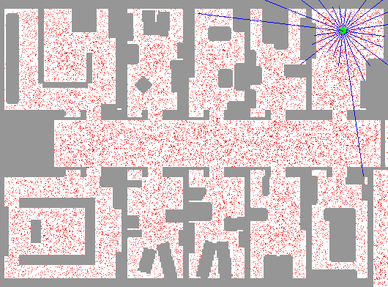
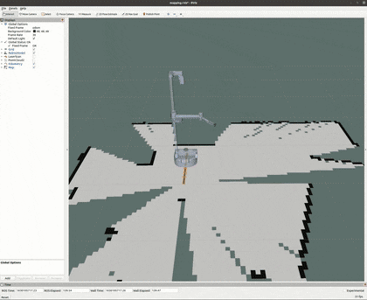
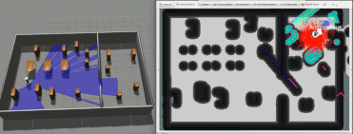

Slide 16
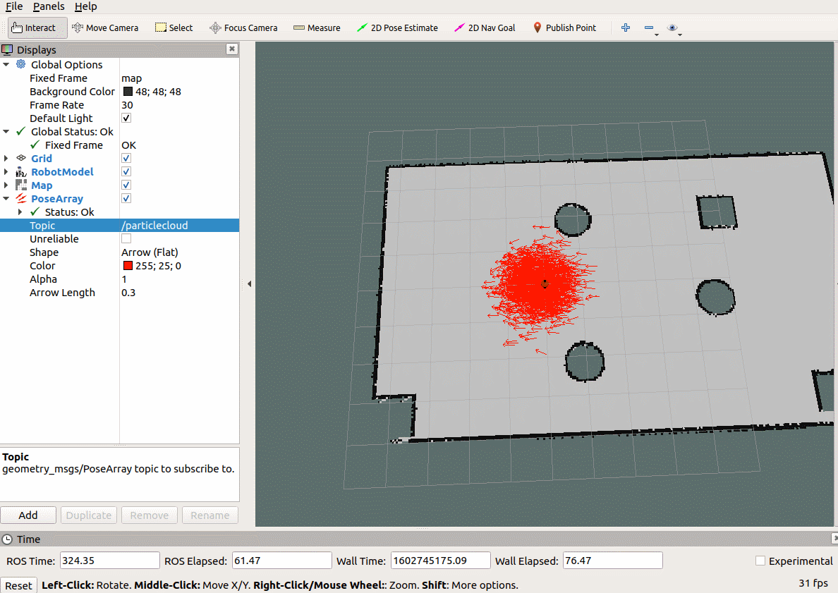
The more dense the arrows are, indicating that the current robot is in The higher the probability of this position

Slide 17
Thank You

